Slide 1
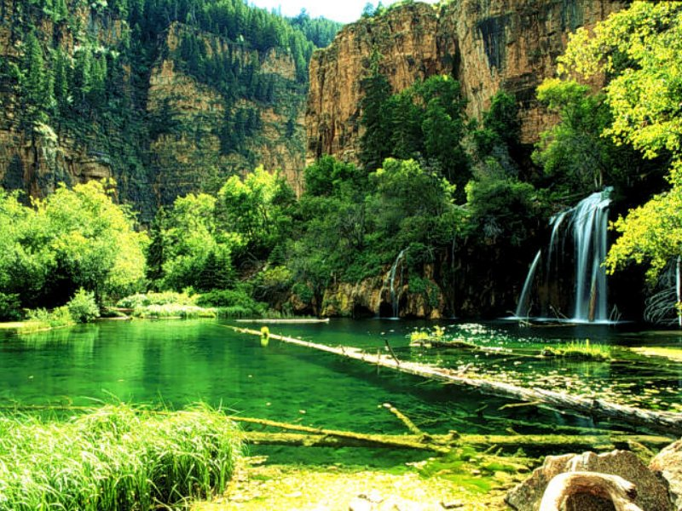
CONTENS
DEFINITION OF SOIL POLLUTION
CAUSES OF SOIL POLLUTION
EFFECTS OF SOIL POLLUTION ON HUMAN AND NATURE
PREVENTION OF SOIL POLLUTION

Slide 2
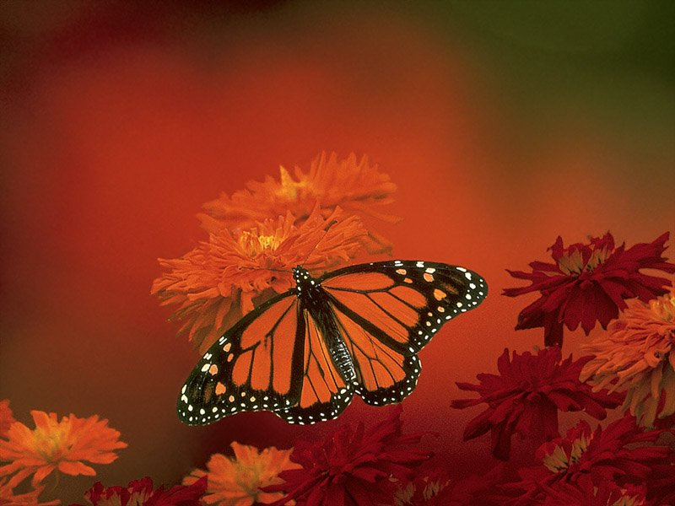
DEFINITION OF SOIL POLLUTION
It is called ‘soil pollution’ when harmful substances penetrating into or on the soil deterionate
the properties of the soil.

Slide 3
CAUSES OF SOIL POLLUTION
Chemical Causes;
Plants are poisoned with pesticides.
This poisen mixes the soil with rain water.

Slide 4
Nuclear Causes;
Accidents in nuclear power plants affect a very large area. Cause people to get sick ans die…

Slide 5
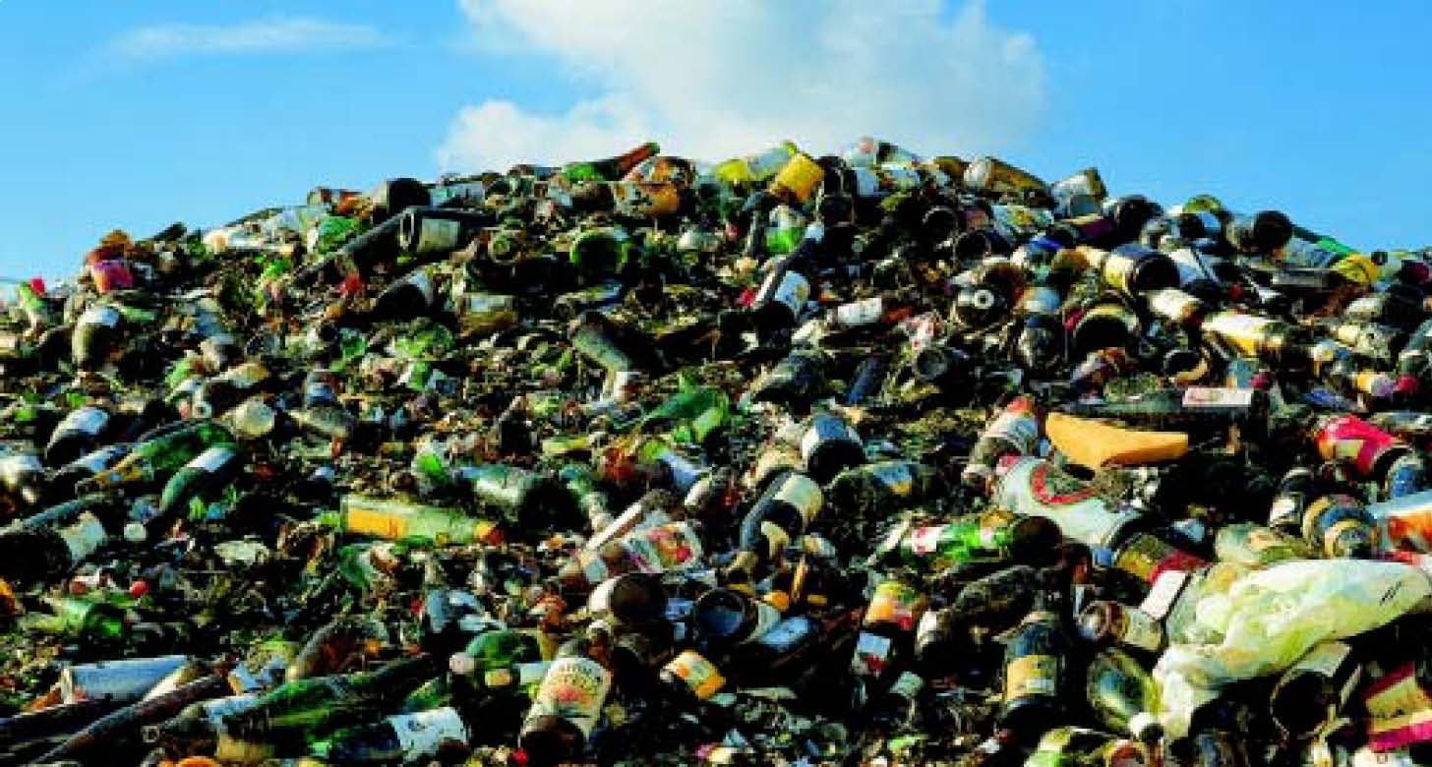
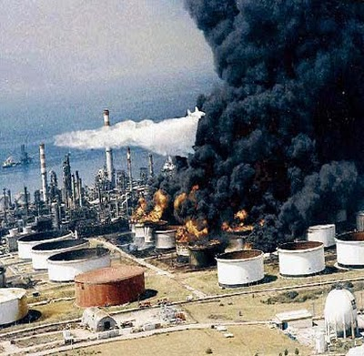
3. Industrial Garbage;
Factory Garbage
Hospital garbage

Slide 6
Loss of fertile land…

Slide 7
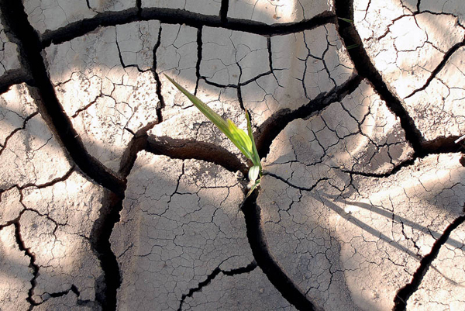
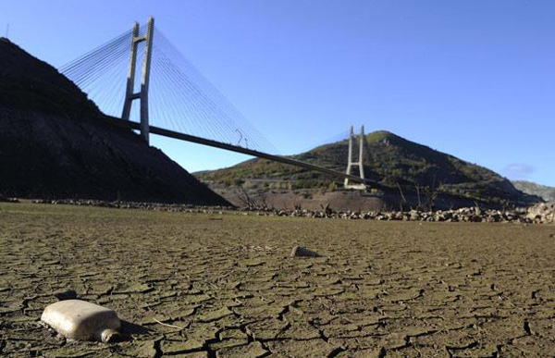
Soils dried by acid rain…

Slide 9
Soil contamination by Sewage water…

Slide 10
EFFECTS OF SOIL POLLUTION ON
HUMAN AND NATURE
If the naturel stracture of the soil is disturbed, plant and animal will not live. If wastewater is used in agriculture, chemical cause soil pollution. This chemical matters harmful for human and animals…

Slide 11
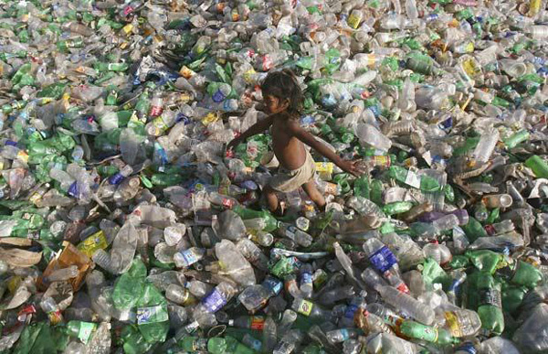
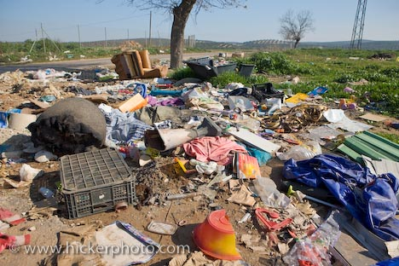

Slide 12
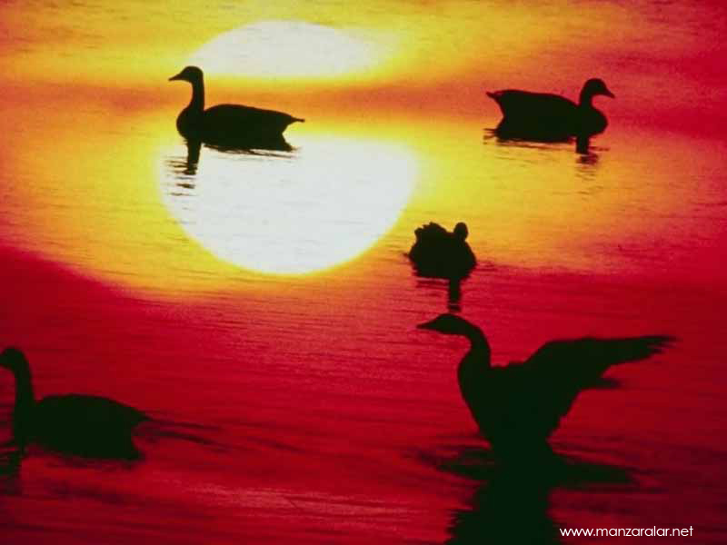
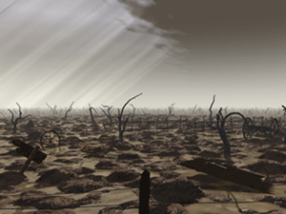
PREVENTION OF SOIL POLLUTION
1- Green areas should be increased.
2- Hausehold and industrial wastes should not be left to nature.
3- Harmful fertilizers and pesticides that are harmful to nature should not be used.
4- The use of nuclear energy should be used scientifically and without harming the nature
Toprak kirliliğinin sonuçları
SALGIN HASTALIKLAR ,
TARIM ÜRÜNLERİNİN AZALMASI,
ÜRÜNLERİN PAHALANMASI,
HAYVANLARIN ÖLMESİ,
BİTKİ ÖRTÜSÜNÜN YOK OLMASI,
HAYVAN NESİLLERİNİN TÜKENMESİ,

Slide 14
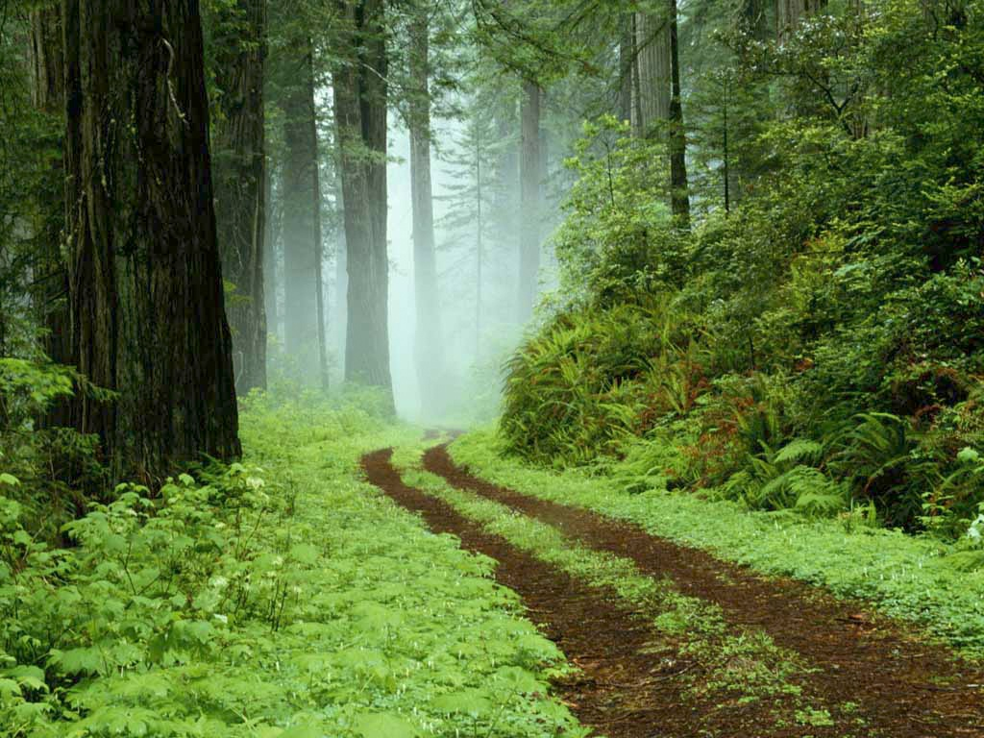
LET’S NOT FORGET THAT THİS WORLD İS OURS,
BUT
WE ARE NOT ALONE İN THİS WORLD…

Slide 15
WE INVITE YOU TO BE MORE CAREFUL ABOUT ENVIRONMENTAL POLLUTION…

Slide 16
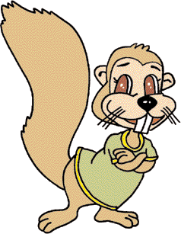
THANK YOU FOR LISTENING TO US…

