Slide 1
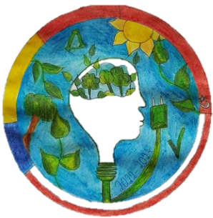
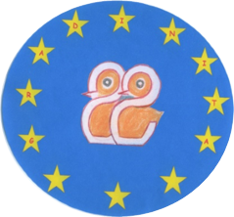
Think Green
2021-2-PL01-KA210-SCH-000051185
GRADINITA CU PROGRAM PRELUNGIT NR.22, IASI, ROMANIA
The forest, the eternal story of green gold, due to the fulminant evolution of science and technology, is forced to launch an S.O.S because the profit from technology is harming the future of life on earth

Slide 2
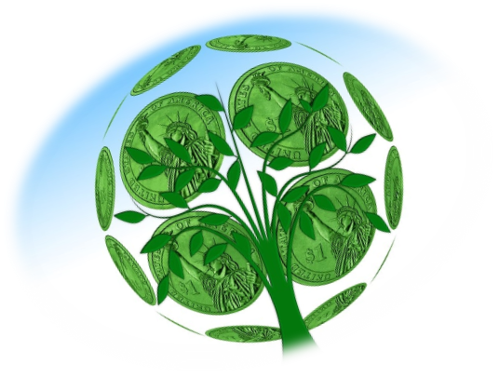
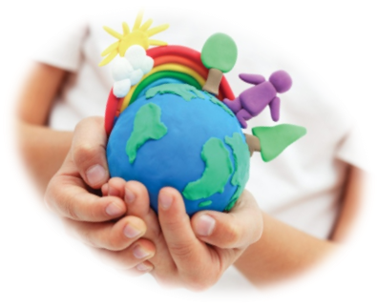
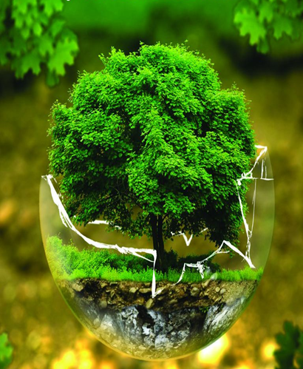
In Romania we now have approximately 7 million hectares of forests. Our mission is to conserve them to maintain our biodiversity, climate and increase human well-being.
That is why there is an NGO-backed campaign against deforestation and forest degradation, which are critical threats to the planet, wildlife and the millions of people who directly or indirectly depend on them for survival.

Slide 3
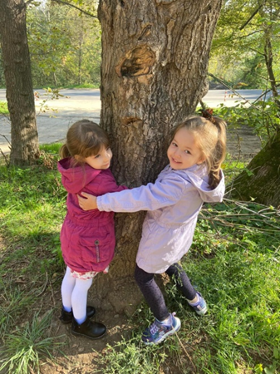
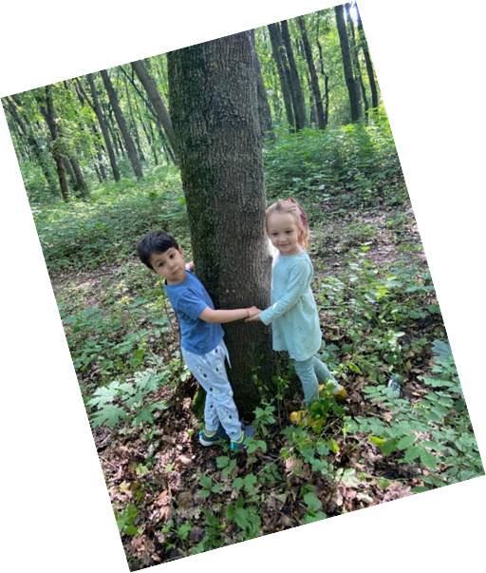
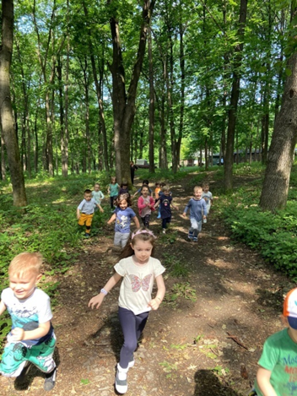
Changing the mentality of a human society has always been the task of education and, in this sense, a campaign to educate the young generation in the ecological spirit has been started worldwide.
The children learned to love the trees, to receive from their energy, they enjoyed playing without the dangers of the street.

Slide 4
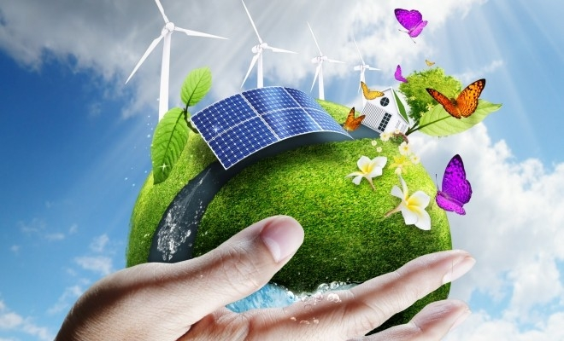
ASAP is a social responsibility program that seeks to generate change in children's behavior towards plastic, from use to separate collection and recycling.
On the occasion of the "Green Week" national program, ASAP makes available to all educational units a kit of activities that teachers can carry out in classes, on the days dedicated to the program.
The ASAP kit contains:
-Separate collection guide: a presentation with basic information about separate collection and the recycling process, a presentation intended for the teacher to be given in class.
- Activity plans: a series of activities for teachers to do with students. There are four important activities: two in the form of a game, an imagination exercise and a practical activity.

Slide 5
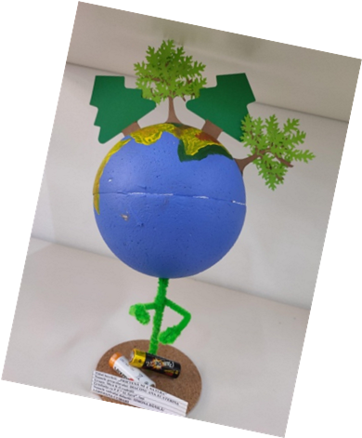
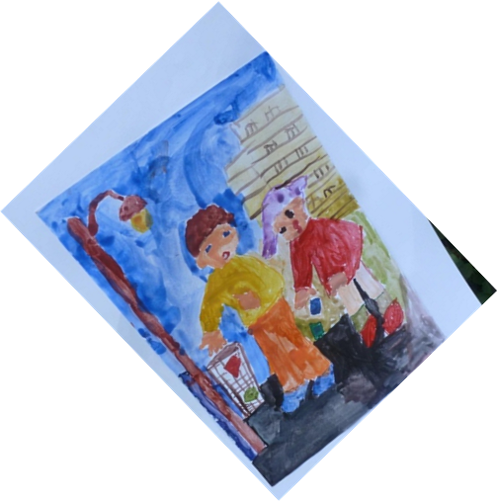
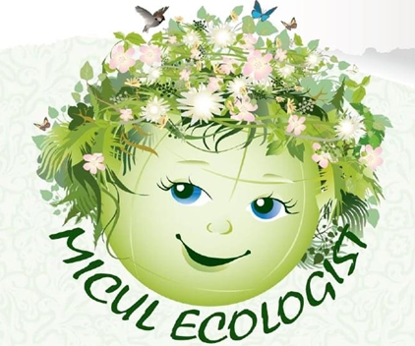
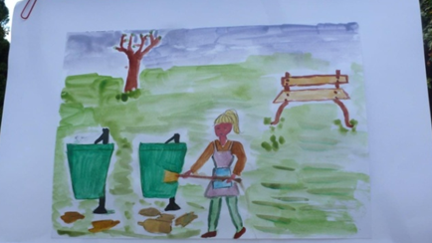
Projects on ecological themes were prioritized for our educational efforts, being carried out according to the specific age of the children in our kindergarten..
,,Little scouts", "Friendship tree", "Little ecologist" "Create „ eco" are projects of the soul that were carried out at the local and national level and which contributed to the initial formation of positive behaviors towards protecting the environment!

Slide 6
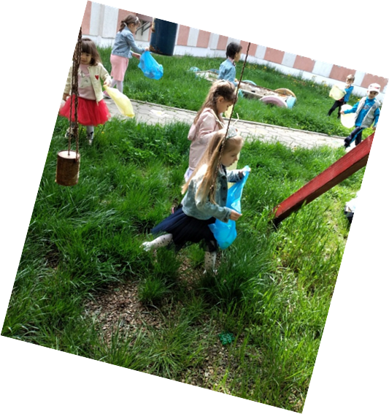
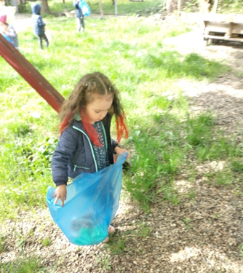
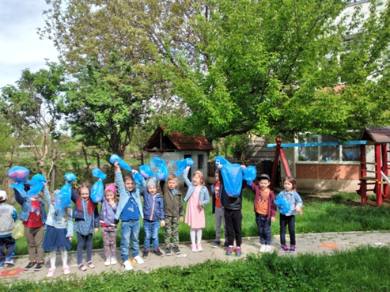
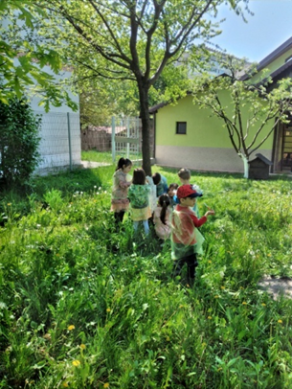
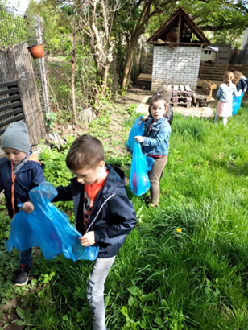
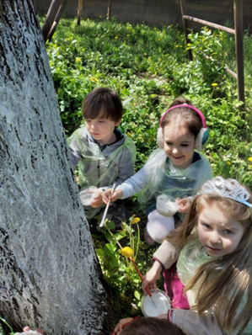
Starting from the premise that you first tidy up your own garden, the children learned that keeping clean, following the rules of waste separation are the first actions to save the blue planet.

Slide 7
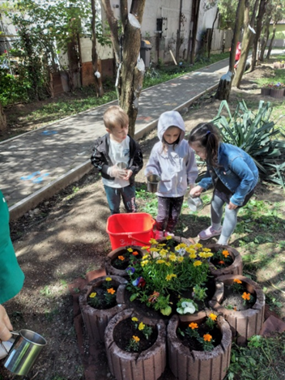
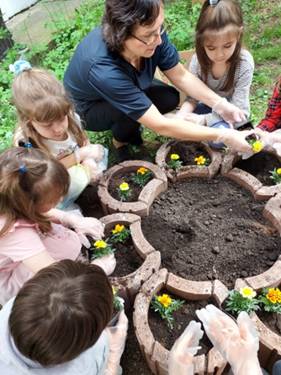
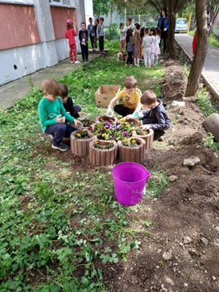
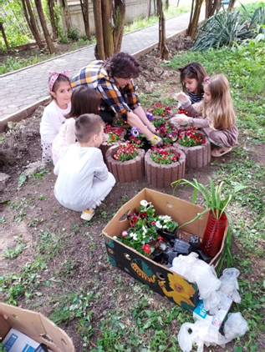
The constant increase in the percentage of the urban population, recorded both globally and in Romania, has led to people moving away from the natural environment.
The teachers ̆encourages and helps children to take the first steps in exploring the environment so that tomorrow will Think Green!

Slide 8
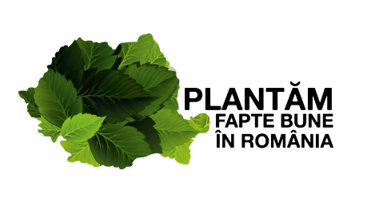
"We plant good deeds in Romania" - is a national afforestation initiative on a voluntary basis, which aims to involve civil society, public institutions, companies and the general public in planting, growing and protecting forests throughout the country.
Vision
We can't do it alone, but together we can change Romania!
Mission
Our mission is to reforest Romania, and you can take part in the change!
https://www.plantamfaptebune.ro/

Slide 9
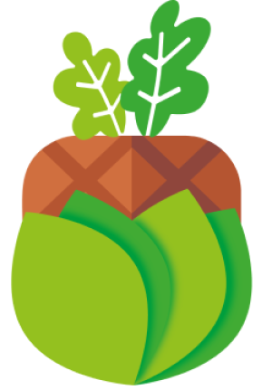
The Land Art Association is a legally registered NGO under the jurisdiction of Romania (EU). Our forests are planted in the center of Romania to benefit from legal protection, peace and stability, guaranteed by the European Union.
ASSOCIATION LAND ART
Welcome to those who are good enough to care and brave enough to act!
Why is Land Art the name of our association?
Every forest is a work of art with a divine touch to which we want to add a twist of human creativity. Wherever the size of the area allows, with the help of different species of trees, we will plant gigantic forest images in the style of the Nazca lines.
https://fundaforest.eu/ro

Slide 10
The Children's Forest Association is present in 24 communities in the south of the country, managing to bring back to life through afforestation over 113 hectares of unproductive land on which approximately 1,000,000 saplings were planted, with the support of 14,697 planting volunteers.
Mission
Our mission is briefly translated into the commitment we have made to:
• Establishing forests in 100 communities in the South-Muntenia Region.
• Teach people to behave like responsible forest custodians, like forest parents.
Vision
The south of the country forested through the involvement of people is more sustainable and acts as a defense shield against climate change for the Bucharest metropolitan area.
https://padureacopiilor.ro/

Slide 11
The objectives of the plantings carried out by the MaiMultiVerde Association are:
The increase of the forested area in Romania, especially (but not limited to) in areas with a shortage of forests, by attracting to the forestry circuit some degraded lands, exposed to the phenomenon of landslides or prone to landslides.
Increasing the level of awareness, responsibility and involvement of citizens in protecting and developing forests and green areas, and promoting their importance, through the presence of volunteers at planting actions.
Increasing the area of ​​green spaces in cities or in their vicinity.
https://maimultverde.ro/

Slide 12
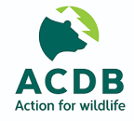
The Association for the Conservation of Biological Diversity (ACDB) works to conserve wildlife species and their habitat. ACDB works for:
• Maintaining healthy bear, wolf, lynx, otter and wild cat populations in the wild
• Educating the public about the benefits of having large carnivores in the wild
• Conserving key protected areas for both species and local communities
• Creating sustainable tourism based on natural values ​​and contributing to nature conservation
• Rescue and treatment of injured or sick wild animals and their reintroduction into the natural environment
VISION
Our vision is that of a world where the values ​​of biological diversity are recognized and preserved and where caring for nature is an important part of people's everyday lives.
MISSION
ACDB fights for the conservation of threatened species and habitats and works with local communities for sustainable development based on respect for nature.
https://www.acdb.ro/

Slide 13
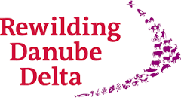
What is renaturation?
Renaturation is a progressive approach to conservation. It's about letting nature take care of itself, allowing natural processes to shape the land and sea, repair damaged ecosystems and restore degraded landscapes. Through re-education, the natural rhythms of wildlife create wilder and more biodiverse habitats.
Our mission
We want to make Europe a wilder place, with more space for wild nature, wild animals and natural processes. Returning to the variety of life, we will continue to explore new ways for people to enjoy and make a fair living from the wild.
Our vision
Wild nature is recognized as a fundamental part of Europe's heritage and an essential element in a modern, prosperous and healthy society.
https://rewilding-danube-delta.com/

